Slide 1
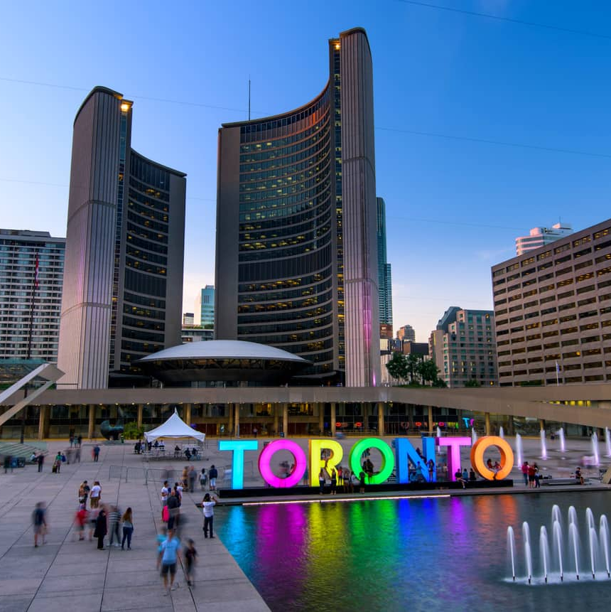
The Battle of neighborhoods
Segmentation and clustering of neighborhoods in Toronto

Slide 2
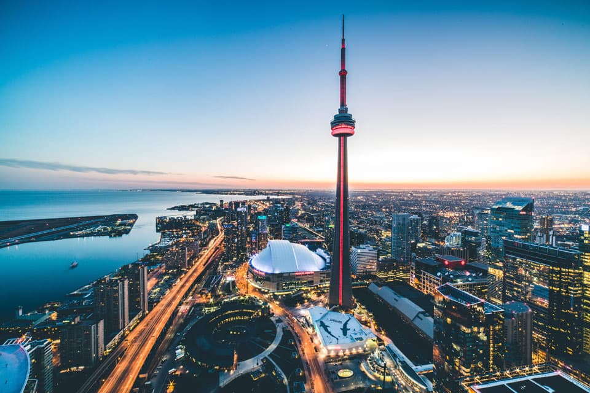
introduction
This data science capstone project is for IBM Data science professional certificate. In this project I am creating a hypothetical situation for a concept that there may not be enough Indian restaurants in Toronto. So it might be a great opportunity for a entrepreneur living in that area

Slide 3
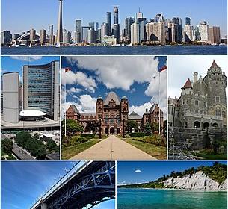
Segmentation
Segmentation is the process of putting customers into groups based on their similarities. When we segment, we know who to target. For instance, you own a consulting company that helps new businesses improve their decision-making capabilities using data analytics.

Slide 4
Segmentation
In this example, your targets are small businesses who opened their company in less than a year. It is natural to assume that this category will need your services. Finding new business owners with less than a year of experience is the process of segmentation. This is important because many businesses established in the field already know about data analysis and may not need your services. Customizing your marketing for this segment makes sense.

Slide 5
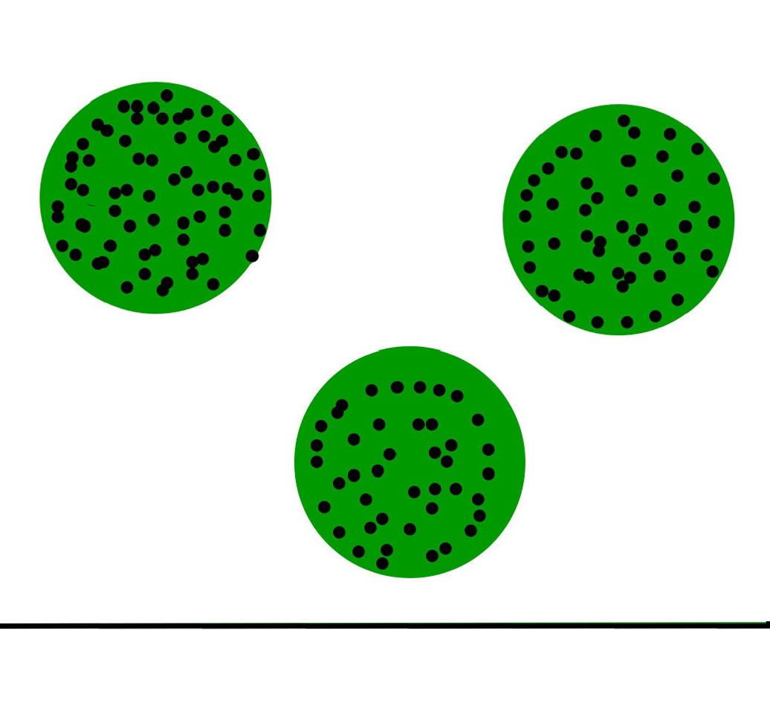
clustering
Clustering is the task of dividing the population or data points into a number of groups such that data points in the same groups are more similar to other data points in the same group and dissimilar to the data points in other groups.
For ex– The data points in the graph below clustered together can be classified into one single group. We can distinguish the clusters, and we can identify that there are 3 clusters in the picture.

Slide 6
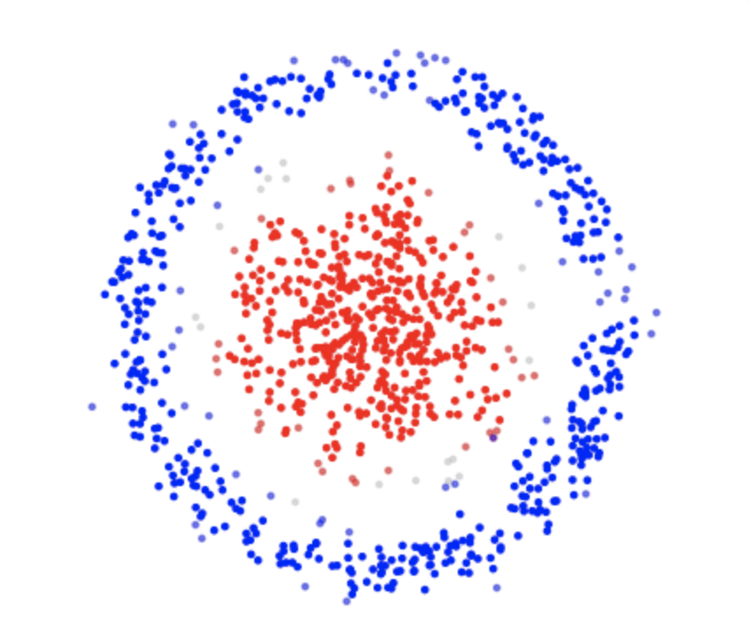
Clustering Methods
Density-Based Methods : These methods consider the clusters as the dense region having some similarity and different from the lower dense region of the space. These methods have good accuracy and ability to merge two clusters. Example DBSCAN,OPTICS
Hierarchical Based Methods : The clusters formed in this method forms a tree-type structure based on the hierarchy. New clusters are formed using the previously formed one. It is divided into two category:
Agglomerative (bottom up approach)
Divisive (top down approach)
DBSCAN CLUSTORING ALGORITHM

Slide 7
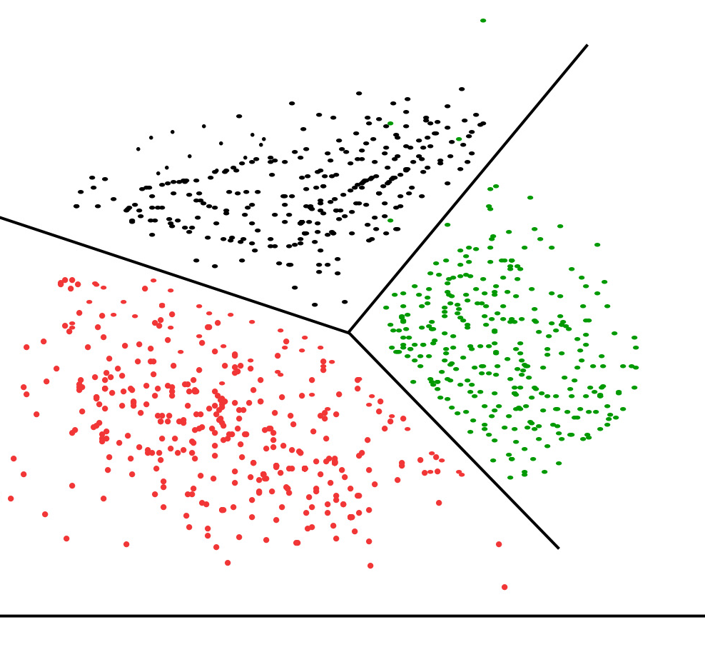
K-means algorithm
K-means algorithm is the simplest unsupervised learning algorithm that solves clustering problem.
K-means algorithm partition n observations into k clusters where each observation belongs to the cluster with the nearest mean serving as a prototype of the cluster .
The way k-means algorithm works is as follows:
Specify number of clusters K.
Initialize centroids by first shuffling the dataset and then randomly selecting K data points for the centroids without replacement.
Keep iterating until there is no change to the centroids. i.e. assignment of data points to clusters isn’t changing.
K-MEANS CLUSTORING ALGORITHM

Slide 8
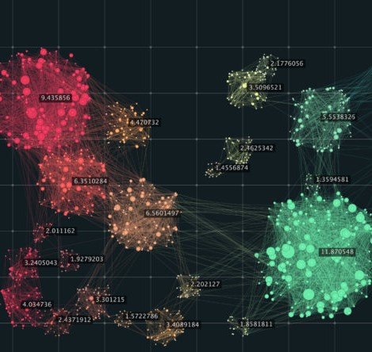
Application of Clustering
Marketing : It can be used to characterize & discover customer segments for marketing purposes.
Biology : It can be used for classification among different species of plants and animals.
Libraries : It is used in clustering different books on the basis of topics and information.
Insurance : It is used to acknowledge the customers, their policies and identifying the frauds.

Slide 9
Business problem
The Objective of this project is to find the best location for this entrepreneur to open a Indian restaurant in Toronto, Canada. With the help data science methods and tools along with machine learning algorithm like clustering and foursquare API, this project aims to find the most suitable location to open a Indian restaurant where most of the Asian community resides

Slide 10
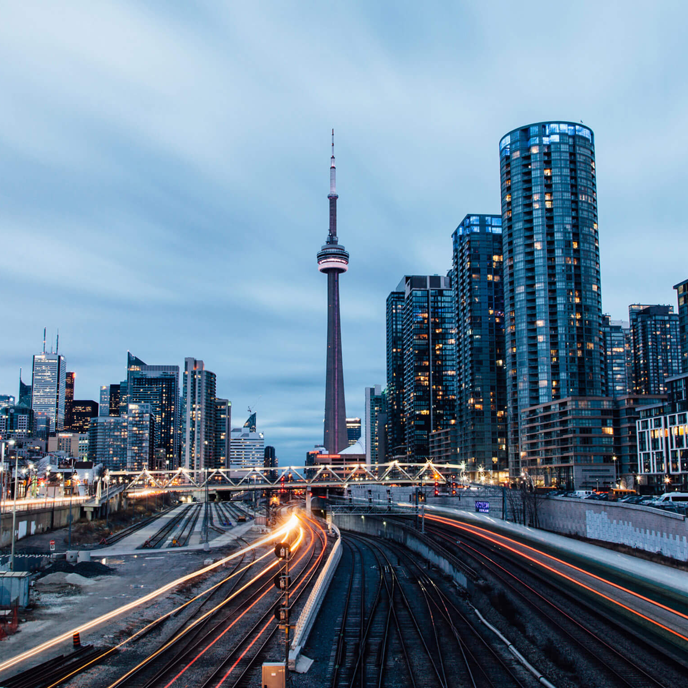
Data section
To solve this problem, we will need below data:
List of neighborhoods in Toronto, Canada
Longitude and latitude of these neighborhoods
Venue data related to Indian restaurants. This data will help in selecting the most suitable neighborhood to open an Indian restaurants
Getting latitude and longitude data of these neighborhoods using Geocoder package
Using foursquare API to get venue data related to these neighborhoods. We can filter these venues to get only Indian restaurants

Slide 11
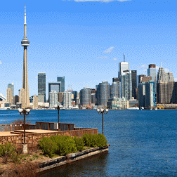
Methodology
First I need a list of all neighborhoods in Toronto, Canada. This is possible by extracting the list of neighborhoods from Wikipedia: https://en.wikipedia.org/wiki/List_of_postal_codes_of_Canada:_M,
Then, I need to get the coordinates of these neighborhoods to utilize foursquare to pull the list of venues near these neighborhoods. To get the coordinates, i used the geocoder package

Slide 12
Methodology
Next, I use the foursquare API to pull the list of top 100 venues within 500 meters radius.
Then, I analyze each neighborhood by grouping the rows by neighborhood and taking the mean on the frequency of occurrence of each venue category. This is to prepare for clustering to be done later
Here I made a justification to specifically look for “Indian restaurants”. Lastly I performed the clustering method by using k-means clustering algorithm. I have clustered the neighborhoods in Toronto into 3 clusters based on their frequency of occurrence for “Indian food”. Based on the results, I will be able to recommend a ideal location to the entrepreneur to open a restaurant

Slide 13
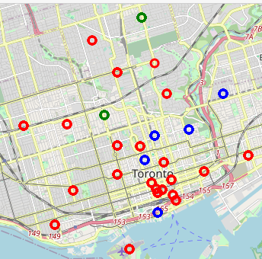


Result
CLUSTER 0
CLUSTER 1
Cluster 0 is represented by red color. According to this map, there are no Indian restaurants in these neighborhoods
Cluster 1 is represented by blue color. According to this map, cluster 1 has maximum number of Indian restaurants in these neighborhoods. So it will be difficult for a entrepreneur to open a restaurant in these neighborhoods

Slide 14
Result
CLUSTER 1
CLUSTER 2
Cluster 1 is represented by blue color. According to this map, cluster 1 has maximum number of Indian restaurants in these neighborhoods. So it will be difficult for a entrepreneur to open a restaurant in these neighborhoods
Cluster 2 is represented by green color. According to this map, cluster 3 has least number of Indian restaurants in these neighborhoods. So this cluster might be a good location as there are not much Indian restaurants in that area.

Slide 15
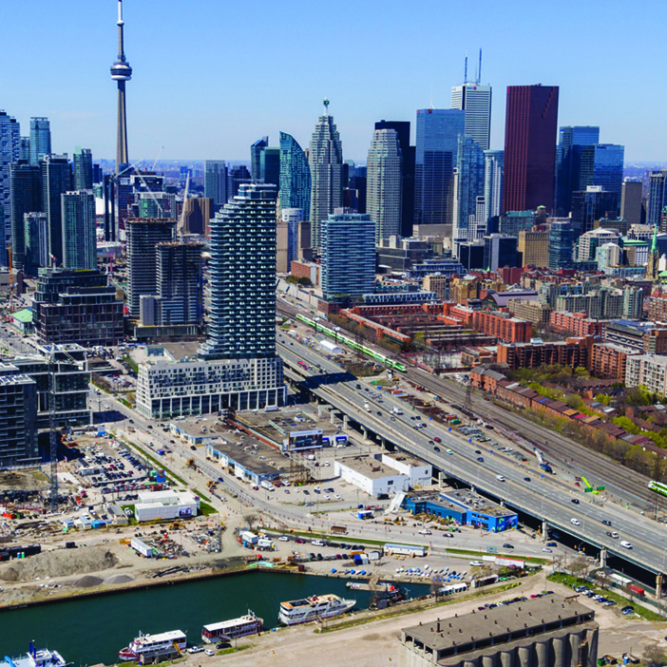
conclusion
Most of the Indian restaurants are in cluster 1 which is around St James Town, Church and Wellesley, Central Bay street, The Danforth West and Harbourfront East, lowest in cluster 2 areas which are in The Annex and Davisville
We can conclude from this project that cluster 1 has the maximum number of Indian restaurants in that area and any new entrepreneur can select cluster 2 location to open a authentic Indian restaurant

Slide 16
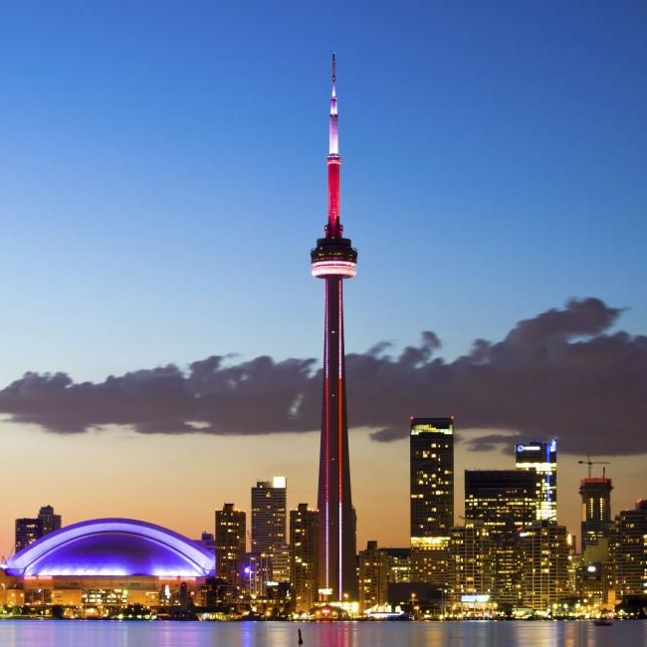
Thank you!
himanshu131198@gmail.com
https://github.com/himanshu345-sys/Coursera_Capstone/blob/master/data%20science%20project%20week%205th.ipynb

